Slide 1
The Nervous System

Slide 2
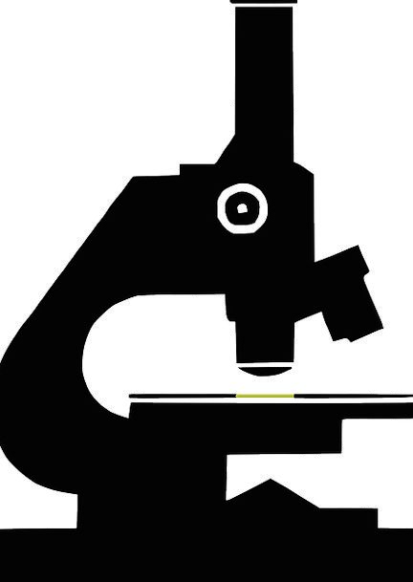
Learning Objectives
Identify the structures of the nervous system
Describe the main functions of the nervous system
Investigate how organisms respond to internal and external stimuli

Slide 3

Stimulus
A stimulus is any internal or external change that brings about a response.
Sounds, smells, light, hunger, temperature, etc.

Slide 4
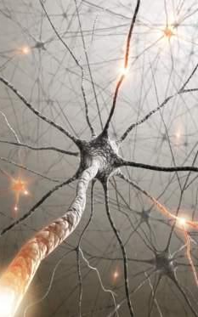
The nervous system helps the body adjust to changing stimuli in three ways:
Collects stimuli from the body and external environment
Processes and interprets the stimulus
Responds appropriately to the stimulus
Maintaining a stable internal environment, despite changes in the external environment (stimuli) is called homeostasis

Slide 5
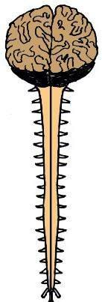
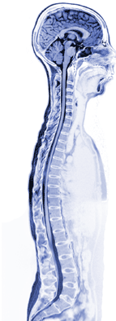
The Nervous System has two parts:
1. Central Nervous System
Brain
&
Spinal Cord
2. Peripheral Nervous System
Nerves in the body

Slide 6
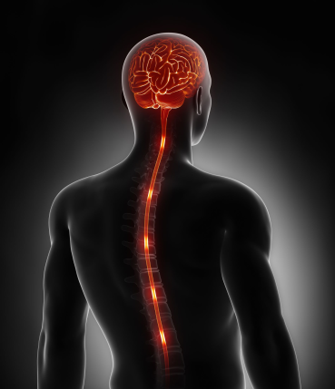
The central nervous system (CNS) contains the brain and spinal cord
Body’s control center
Processes sensory input
Maintains homeostasis
Higher functions: language, emotions, memories, creativity, personality

Slide 7
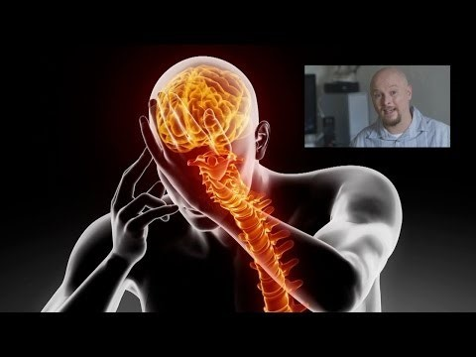
Watch This!
YouTube link: https://www.youtube.com/watch?v=o3yFSOeB5c4

Slide 8
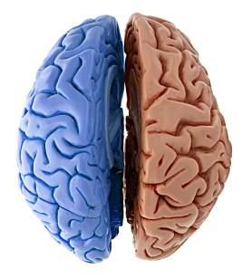
The Brain
Your brain coordinates all of the body’s activities.
It is divided into two hemispheres (or halves) that have contralaterality = contra – opposite, lateral – side
Left half
Right half
The left half of your brain controls the right side of your body…
and the right half of your brain controls the left side of your body.

Slide 9
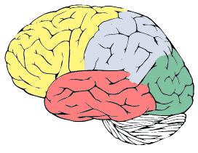
The cerebrum is the largest part of the brain. It is divided into four lobes; each with specific functions.
1. Frontal Lobe
Personality
Speaking
Making plans
Reasoning / Logic
2. Parietal Lobe
Sense of touch
Map of the body
Movement
Sense of where you are in your environment
4. Occipital Lobe
Vision
3. Temporal Lobe
Hearing
Understanding language

Slide 10
The cerebellum provides the body with coordination and balance.
Cerebellum
Coordinate voluntary movements
Maintain muscle tone
Maintain balance

Slide 11
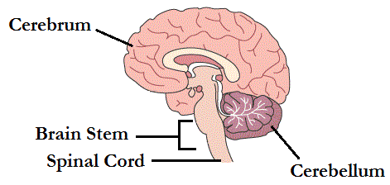
Brain to Spinal Cord
Your cerebrum and cerebellum are attached to the spinal cord at the
brain stem.
The brain stem controls involuntary body functions or functions that we don’t have to think about: breathing, making your heart beat, digesting your lunch…

Slide 12
Check Your Brain Waves
Draw a line to the portion of the brain that controls each activity.
Riding a bicycle
Digesting your lunch
Recalling information about the nervous system in order to answer a test question
Notes:
Hank’s team: Click on images and receive “correct” or “incorrect” feedback or draw a line to the correct portion of the brain
Answers: “Riding a bicycle → cerebellum”, Digesting your lunch → Brain Stem; Recalling information about the nervous system in order to answer a test question → cerebrum

Slide 13
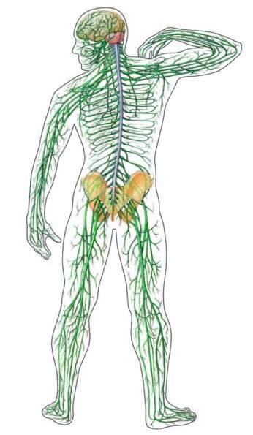
Spinal Cord
The spinal cord is the main information pathway.
Our body sends sensory messages up to the brain via the spinal cord…
and the brain sends movement messages down the spinal cord to the body.

Slide 14
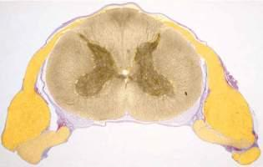
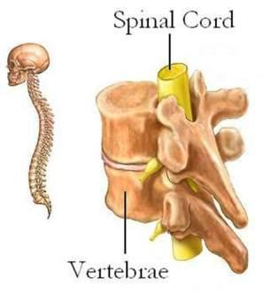
Spinal Cord
The spinal cord is made of long bundles of nerve cells
The spinal cord is surrounded by bones for protection
Spinal cord slice
These bones are called vertebrae

Slide 15
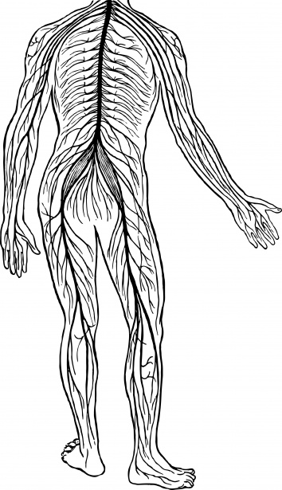
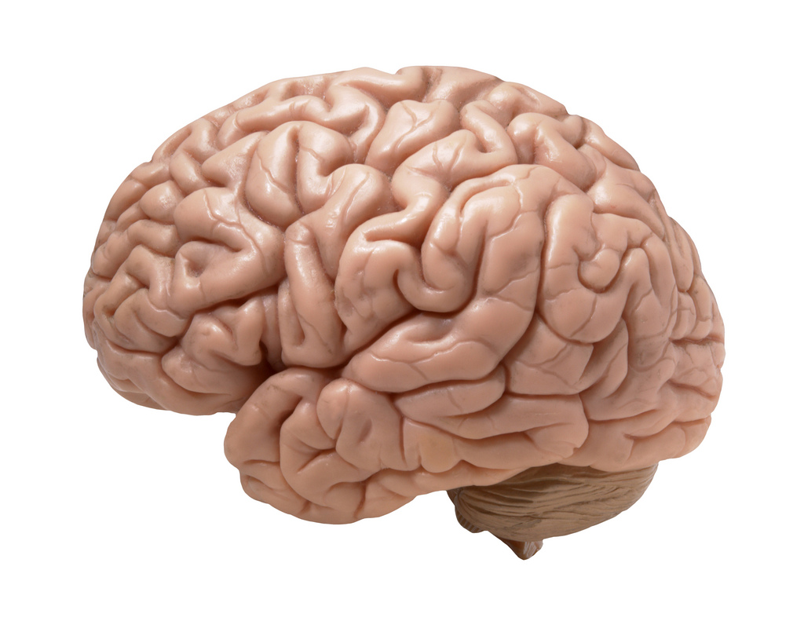
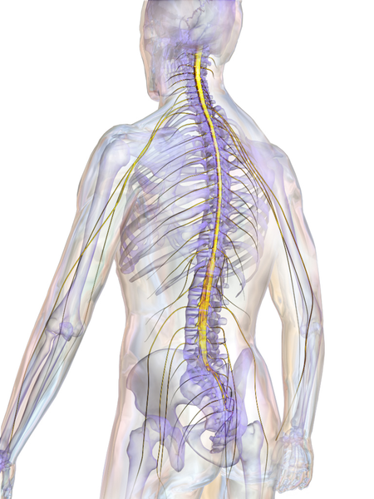
Central Intelligence Check
The central nervous system includes which structure(s)? Choose all that apply.
Notes:
Hank’s team: Click on images and receive “correct” or “incorrect” feedback
Answers: brain and spinal cord (middle and last image)

Slide 16
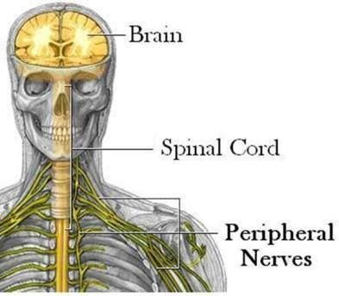
Peripheral Nervous System
The peripheral nervous system (PNS) is made up of nerves that run throughout our body.
12 pairs of cranial nerves from the brain
31 pairs of spinal nerves from the spinal cord
Nerves tell our brain about our environment with information gathered from our senses.

Slide 17
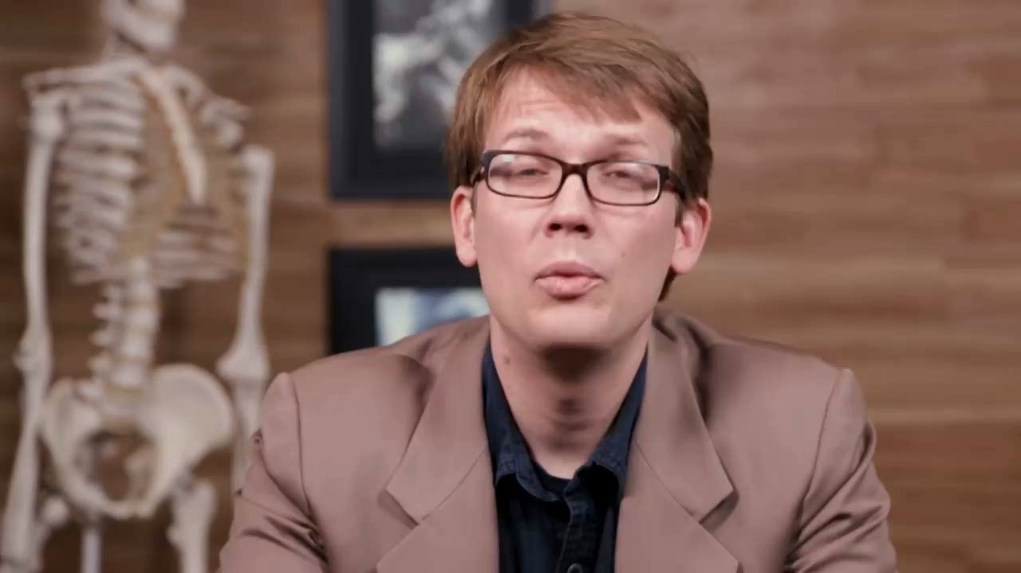
I’m Sensing Something Important
Video – “Peripheral Nervous System Intro – Crash Course” in Kristen Watts folder, stress app materials
https://youtu.be/oqEYR9G6Cr0

Slide 18
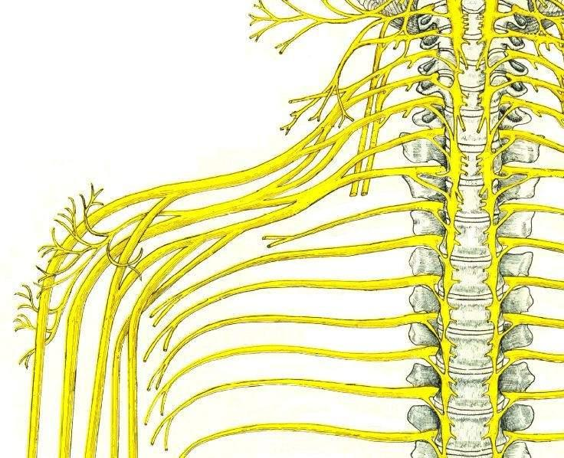
Nerves
Nerves carry two types of information
Movement
Sensory
Nerves have special receptors for each sense:
Thermoreceptors - temperature
Mechanoreceptors – touch or sound
Photoreceptors - light
Nociceptors - pain

Slide 19
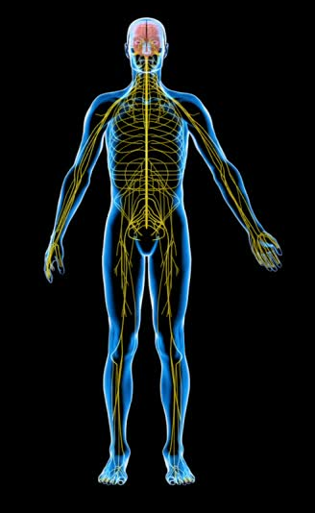
Peripheral Nervous System
Divided into Somatic and Autonomic
Somatic – voluntary actions (skeletal muscles)
Cranial and spinal nerves from the CNS to skeletal muscles
Autonomic – involuntary actions (respiration, digestion, circulation, etc…)

Slide 20
Can You Sense the Answers?
The peripheral nervous system is made up of _ _ _ _ _ _ and has two divisions: the _ _ _ _ _ _ _ _ _ and _ _ _ _ _ _ _
Notes:
Hank’s team: Hangman or similar
answers are: nerves, autonomic, somatic

Slide 21
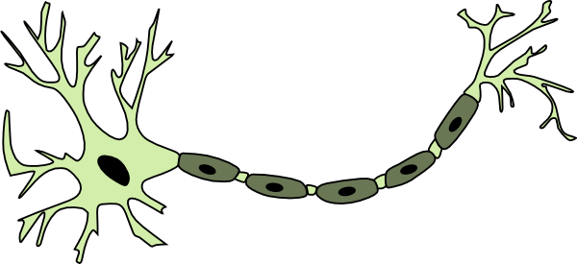
Nervous system cells are called neurons
Soma the cell body – contains the nucleus
Dendrites receive information from other neurons and send them to the cell body
Axons take information away from the cell body
NEURON

Slide 22
How do neurons communicate with each other?
 Electrical and chemical information flows from one neuron to another neuron across a gap called a synapse

Slide 23
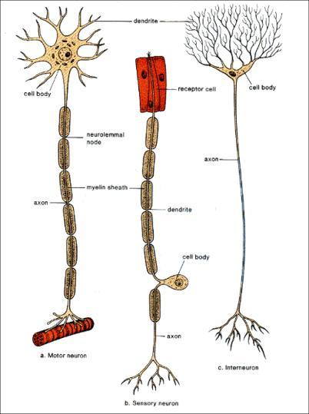
Neuron Types
Sensory neurons receive and send signals to the CNS
Motor neurons sends signals to effectors (muscles & glands) to cause reactions
Interneurons, within the CNS, relay messages between sensory and motor neurons

Slide 24
Label the Neuron
Axon nucleus
Cell body away
Synapse to
Dendrite across
Location of the ________
Takes information from other neurons _____ the cell body
Takes information ________ from the cell body
Electrical and chemical information moves __________ this space
Notes:
Hank’s team: Click and drag words to correct blank.
Answers: top right – cell body, location of the nucleus; top left – Dendrite, Takes information to the cell body; middle right – Axon, Takes information away from the cell body; bottom right – Synapse, Electrical and chemical information moves across this space.

Slide 25
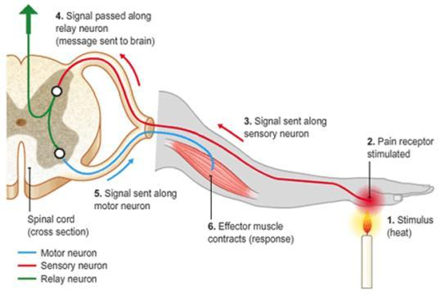
A reflex is an involuntary, automatic response to a stimulus. It involves a simple nerve pathway called a reflex arc.
Controlled in the spinal cord not the brain
Allows you to react without thinking
Stimulus received by sensory neurons
Decision made by the interneurons
Response by the motor neurons (resulting action)

Slide 26
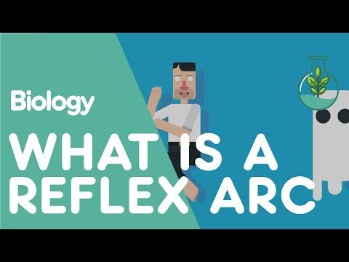
https://youtu.be/Nn2RHLWST-k

Slide 27
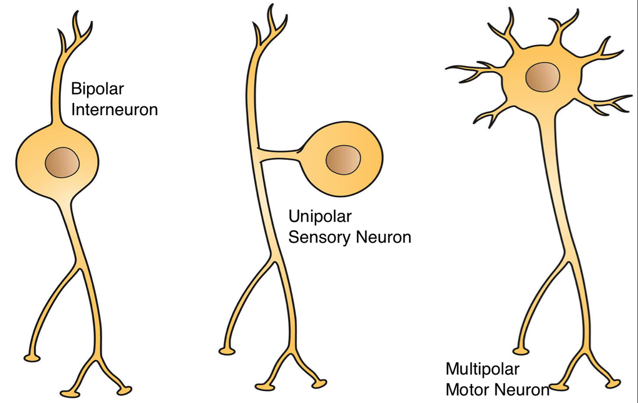
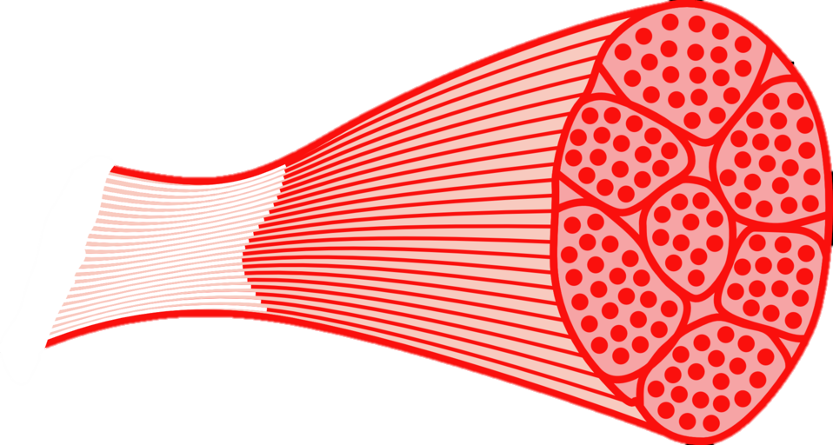
Map the Response
Ouch! You stepped on a sharp rock. Map the nerve pathway that caused you to lift your foot.
Skeletal muscle
Spinal cord
Notes:
Hank’s team: Move labeled images into the correct order
Answers: Sensory neuron, spinal cord, interneuron, motor neuron, skeletal muscle

Slide 28
The Endocrine System

Slide 29
Learning Objectives
Identify the structures of the endocrine system
Describe the main functions of the endocrine system

Slide 30
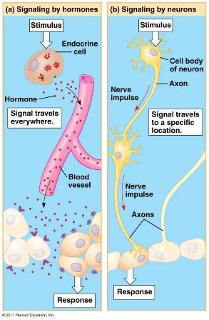
Control Systems
The endocrine system works with the nervous system to control the body’s functions.
The endocrine system communicates with the body through chemical messengers.
The body responds more slowly to the endocrine system than the nervous system.

Slide 31
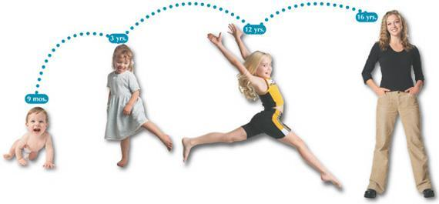
Endocrine System
Regulates body functions through a collection of glands which produce hormones.
Metabolism, growth and development, reproduction, sleep, mood, etc…

Slide 32
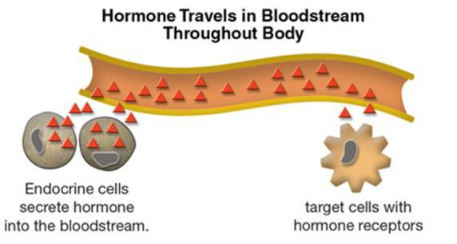
Hormones
Chemical messengers
Travel from glands into the blood stream to target cells
Target cells have receptors for specific hormones so each cell communicates only with specific hormones

Slide 33
Regulate Your Knowledge
Choose the correct word to finish the sentences.
The endocrine/nervous system regulates body functions. It uses electrical/chemical messengers called hormones/impulses to communicate with the body. The body responds quickly/slowly to these messages.
Notes:
For Hank: Students choose the correct word(s) for each sentence and receive correct or incorrect feedback (word, color, sound, etc.)
Answers: endocrine, chemical, hormones, slowly

Slide 34
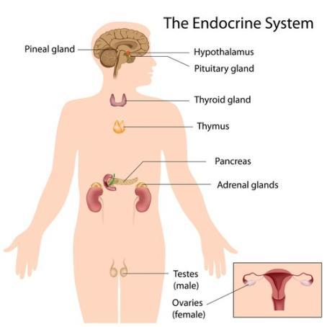
Glands of the Endocrine System
Gland - group of cells that produce and secrete chemicals called hormones
Hypothalamus
Pituitary gland
Pineal gland
Thyroid
Parathyroid
Thymus
Pancreas
Adrenal Glands
Reproductive Glands

Slide 35
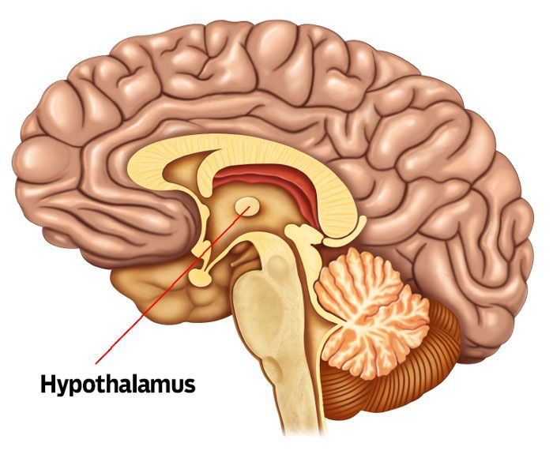
Hypothalamus and Pituitary
Hypothalamus
Located in the brain, the hypothalamus releases hormones which stimulate or suppress the production of other hormones throughout the body.
Pituitary
The master gland! A small gland in the central area of the brain it produces hormones that control other glands and many body functions including growth.
Pituitary

Slide 36
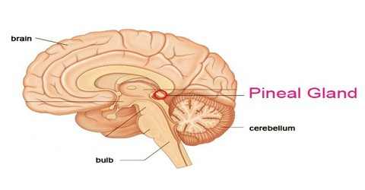
Pineal Gland
The pineal gland is located near the center of the brain, between the two hemispheres.
The pineal gland produces melatonin, which modulates sleep patterns.

Slide 37
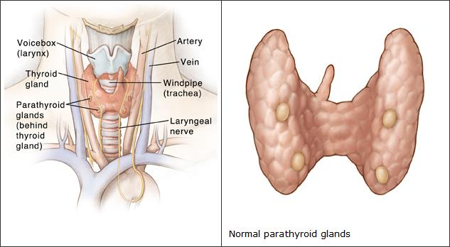
Thyroid and Parathyroid
Parathyroid
Four tiny glands on the thyroid that control the body's calcium levels. If levels get too low the bones will be instructed to release more; if the levels get too high the bones are told to absorb the extra calcium.
Thyroid
A butterfly-shaped gland located in front of the trachea and just below the larynx (voice box). It regulates metabolism, which is the body’s ability to break down food and convert it to energy.

Slide 38
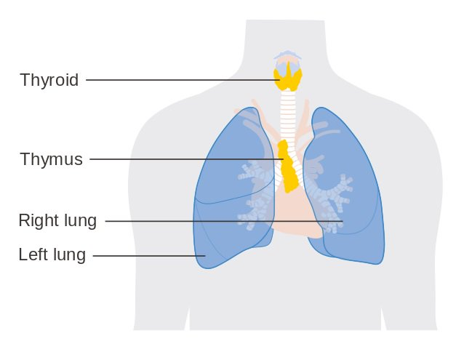
Thymus
A small, irregular-shaped gland in the upper part of the chest, just under the breastbone and between the lungs.
The thymus makes hormones to help T cells (special white blood cells) develop and keep the immune system working properly. T cells travel throughout the body to help fight infection, disease, and foreign substances.
The thymus is large in newborns and toddlers, biggest during puberty, and then slowly begins to shrink.

Slide 39
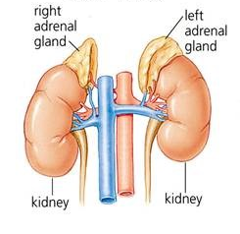
Adrenal Glands
Two triangular glands situated on top of both kidneys.
Known for their role in the body’s response to stress
Adrenaline - plays an important role in the fight-or-flight response by increasing heart and respiration rates, and stimulating the liver to release glucose
Cortisol – acts as an anti-inflammatory, influences memory formation, controls salt and water balance, and influences blood pressure

Slide 40
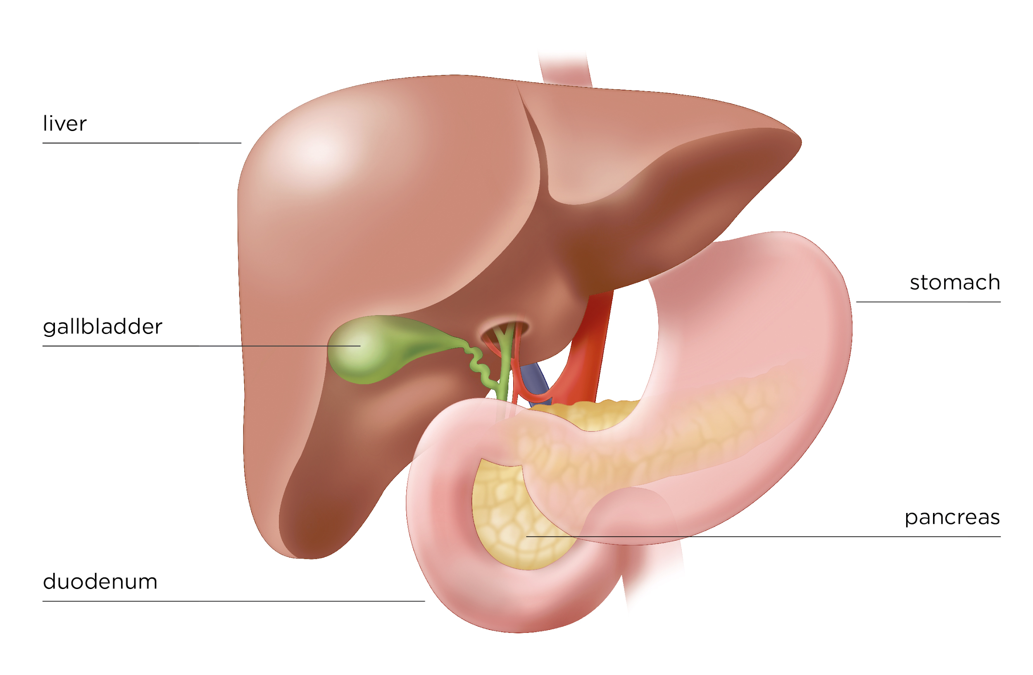
Pancreas
The pancreas is located between the two kidneys
Keeps blood sugar balanced with the hormones Insulin and Glucagon
Insulin - acts to lower blood sugar
Glucagon - acts to raise blood sugar

Slide 41
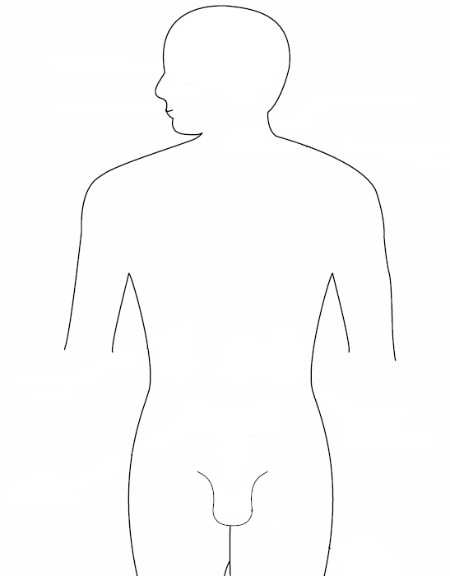
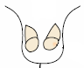
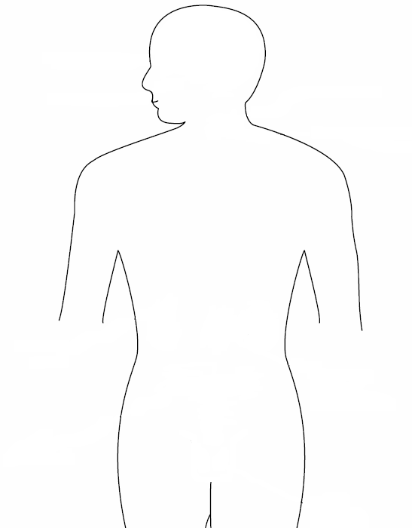
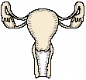
Ovaries and Testes
Ovaries
Ovaries are found in the abdomen of women. They produce hormones which assist with the development of the female reproductive organs and prepare the uterus for pregnancy.
Testes
Testes are found in the scrotum of males. They generate hormones which facilitate the development of male reproductive organs and produce sperm.

Slide 42
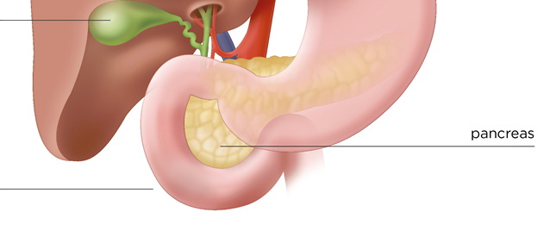
What Can You Produce? Match the endocrine gland with its function or the hormone it produces
Creates adrenaline and cortisol to respond to stress
Regulates blood sugar
Key player in the immune system by developing T cells
The master gland, controls other glands and aids in growth
Pituitary
Notes:
Hank’s team: Drag lines to match statement and organ.
Answers:
Creates adrenaline and cortisol to respond to stress → kidney/adrenal
Regulates blood sugar → pancreas
Key player in the immune system by developing T cells → Thymus
The master gland, controls other glands and aids in growth → pituitary

Slide 43
Homeostasis and Feedback Mechanisms

Slide 44
Learning Objective
Describe how organisms maintain stable internal conditions in response to external and internal stimuli.

Slide 45
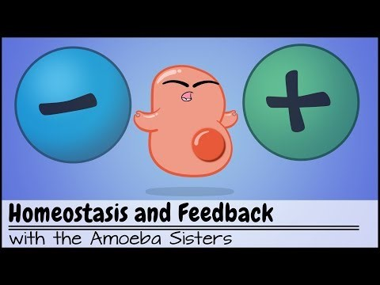
Watch This Balancing Act!
https://youtu.be/Iz0Q9nTZCw4

Slide 46
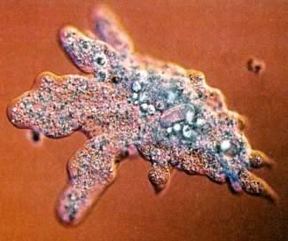
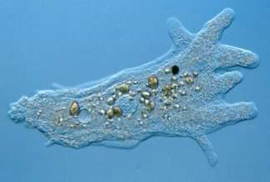
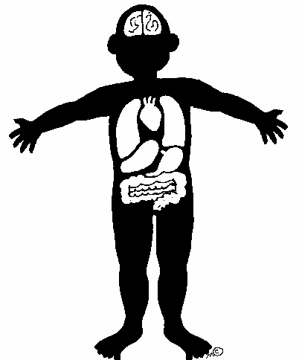
These amoeba take in nutrients and O₂ from their external environment and eliminate wastes generated inside, like CO₂.
All life requires these constant exchanges between their internal & external environments.
External Environment:
Everything outside the body
Wastes are eliminated out
Internal Environment:
Everything inside the body
Nutrients are brought in

Slide 47
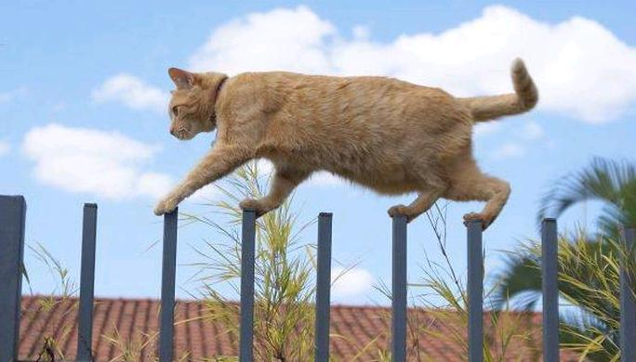
Homeostasis is…
The regulation of steady, life maintaining conditions inside an organism, despite changes in the environment.
When homeostasis is disrupted disease or death can occur.
Homeostasis is achieved by the body’s control centers; the nervous and endocrine systems.
Balance

Slide 48
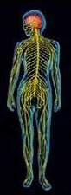
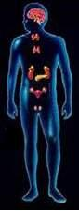
Control Centers
Control centers regulate variables to maintain homeostasis.
The Nervous System & the Endocrine System
They receive signals from their sensors about imbalances and send out corrective signals to their effectors (glands, tissues, organs) to balance out any threats to homeostasis.

Slide 49
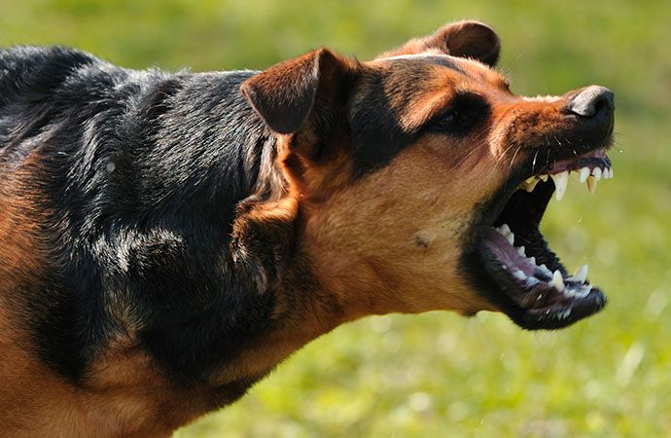

Control Centers – Response to External Stimuli
What do these two images have in common? They both contain stimuli which will likely trigger a fear response.

Slide 50
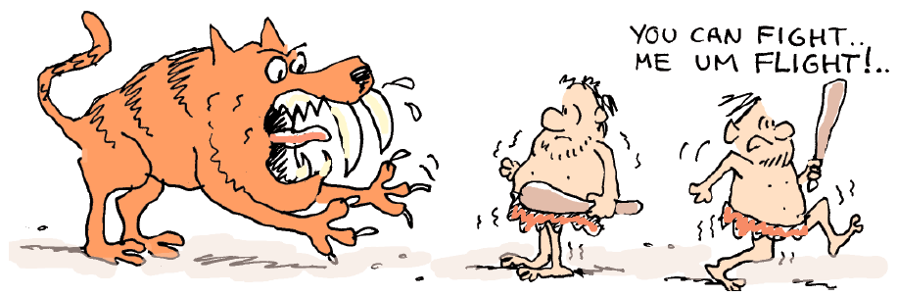
Fight or Flight
The fear reaction is known as the fight or flight response
because it is exactly what the body is preparing to do…..to fight
off the danger or run like crazy to get away! Once the danger is gone the control centers re-establish homeostasis.

Slide 51
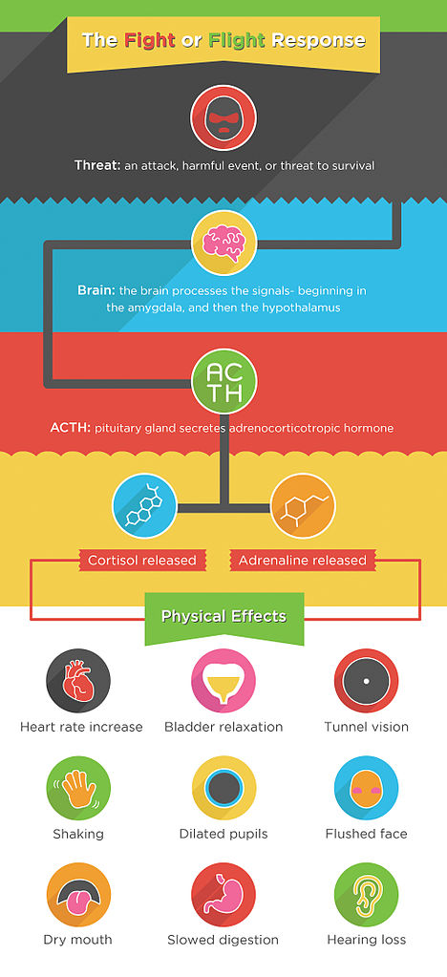
Fight or Flight Physiology
Sensory perception – sensory receptors receive “fear” stimuli
Brain processing - The brain processes stimuli and triggers the hypothalamus which activates the sympathetic nervous and endocrine systems
Messages to the body – pituitary hormones stimulate the adrenal glands to produce the hormone epinephrine (adrenaline)

Slide 52

Fight or Flight Physiology
Physiological effects – adrenaline with other hormones cause:
Liver to releases glucose to provide energy
Increase heart and respiration rate
Slows digestion
Increase blood flow to muscles
Pupils dilate

Slide 53

Control Centers – Response to Internal Stimuli
Vomiting is a reflex that helps protect our bodies from toxins thus maintaining homeostasis.
Stimulus (toxin, bacteria, motion, stress) received by brain or other parts of the nervous system
Decision neurochemicals activate receptors
Response - increased salivation, heart, and respiration rates and contraction of abdominal and respiratory muscles

Slide 54


Keep it in Balance
Place the correct answers on the scale to bring it into balance.
What is the term which means maintaining a constant internal environment despite changes in the external environment?
Which body system(s) help regulate the internal environment?
Balance
Muscular system
Homeostasis
Endocrine system
Stimulus
Nervous system
Reflex arc
Cardiovascular system
Notes:
Hank’s team: maybe have an unbalanced scale which tips/balances based on correct/incorrect drag and drop answers? The images are just ideas for the graphic. I prefer the modern one on the left as many students may have used something similar.
Answers: homeostasis, endocrine system, nervous system

Slide 55


Variables in Homeostasis
1. pH
The relative amount of acid in the body. The human body has a pH range of 6.8 – 7.8. An imbalance in pH would cause our cells to cease functioning and we would die.
2. Concentration of Nutrients
Cells in our body need a constant supply of nutrients and energy.

Slide 56



Variables in Homeostasis
3. Temperature
Cells also have an optimum temperature range. If cells are too cold, their processes slow down. If they get too hot, their proteins will lose their shape (denature) and stop working.
4. Water Levels
The amount of water lost from the body should equal the amount of water consumed. Minerals in the body (Sodium, Potassium, and others) help regulate water levels in cells. It is important to maintain proper volume; too little water and they shrivel up, too much water and they can burst!
.
shrivel up
normal
burst

Slide 57

Variables in Homeostasis
5. Waste Removal
Chemical reactions often produce byproducts called cellular waste that have a toxic effect on the body if they accumulate. Cellular respiration is how the body converts sugar (glucose) to energy. Carbon Dioxide is a byproduct of cellular respiration. Too much Carbon Dioxide can affect the body’s pH.

Slide 58
Can You Keep Things in Balance? Simulation examples
https://www.explorelearning.com/index.cfm?method=cResource.dspView&ResourceID=659
https://kamu.pbslearningmedia.org/resource/tdc02.sci.life.reg.bodycontrol/body-control-center/
https://www.brainpop.com/games/codefredsurvivalmode/
Notes:
For Hank’s team. Would it be possible to design something like these?

Slide 59

Maintaining Homeostasis
The homeostatic variables previously listed (pH, temperature, etc.) all have set points, or target levels, at which cells function optimally.
The body’s control systems determine and maintain the variables’ set point.
When these variables fall too low or too high from the set point our cells may cease functioning.

Slide 60

Regulation Mechanisms
Our Nervous System & Endocrine System bring imbalanced variables back to their set point through a process called feedback.
Feedback is a reaction or response to a particular process or activity. Body systems use both negative and positive feedback to maintain homeostasis.

Slide 61

Negative Feedback
Negative Feedback occurs when a stimulus causes an opposite output in order to maintain an ideal level of some variable.
Negative Feedback is the most common regulatory mechanism.

Slide 62

Negative Feedback Steps
Feedback loops occur in a series of steps.
Stimulus – a change either in the environment or inside the body system
Sensor – receptors in the body’s control centers detect the change
Control – the nervous or endocrine system determines the proper response to the stimulus
Effector – glands or tissues respond to the change in a manner that aids in a return to homeostasis

Slide 63

Negative Feedback Example
Playing outside on summer day will lead to an increase in body temperature. This temperature change is detected by nerve cells that report to the part of the brain responsible for temperature regulation. The brain then sends out a signal for the body to cool itself down by sweating.
The body responds to an increase in body temperature by decreasing the body temperature. The stimulus resulted in a opposite effect. That is negative feedback.

Slide 64

Positive Feedback
In positive feedback, the body uses the effect of a stimulus/change to perform more of the same behavior. It functions to amplify the change.
A change is detected by a receptor and an effector is activated to induce the same effect – this promotes further change.
Positive feedback loops will continue to amplify the initial change until the stimulus is removed.

Slide 65

Positive Feedback Example
During child birth, labor contractions stimulate the release of the hormone oxytocin, which cause more contractions, which leads to more released oxytocin culminating in delivery of the baby.
Once the baby is delivered oxytocin is no longer released.

Slide 66





Feedback Needed!
Drop the descriptions in the correct place in the feedback loop.
Select whether this is negative or positive feedback.
After eating your blood sugar rises.
Time for lunch! You have low blood sugar (glucose).
In response to higher glucose levels, the pancreas releases insulin into the blood.
Homeostasis! Your blood sugar is within a normal range.
Insulin enables the liver to take up glucose and store it as glycogen.
Notes:
Hank’s team: Can y’all do a drag and drop diagram like pictured above? Students would place text boxes next to/on/etc. the appropriate image. They would also click the word “negative” or “positive” (the correct response is negative).
Answers: shown in diagram and negative

Slide 67

Homeostatic Imbalance
When a variable becomes imbalanced and our control centers cannot maintain homeostasis, disease or death can occur.
These imbalances are called a homeostatic imbalance.
Common diseases that occur due to homeostatic imbalance are diabetes, dehydration, and hypo/hyperglycemia.

Slide 68

Think About It
Consider the last time you were sick, anxious, or stressed. How did your organs and organ systems respond to this imbalance? What might have happened if they were not functioning properly?

